Slide 1
Travel Data
Prabhdeep Kaur
Bhavan Bagri
Cameron Daniel
Josh Barclay

Slide 2
Motivation & Summary
Core Message: Analyzing trends among travel data and delays in the US
Questions:
What are the most common types of delays?
Which day, month, & week has the most delays?
Which airport has the most delays?
Which airline has the least and most delays?
We chose these questions because the results can be useful for travelers who want to avoid delays. In addition, determining the magnitude of different delay types can help airlines and airports prioritize delay mitigation.

Slide 3
Questions & Data
Most common reasons for delay: What type of delay causes the most delay minutes, and what type of delay caused the most number of flights to be late?
Used the delay types columns which have a numeric value corresponding to the number of minutes each flight was late filtered by specific delay type.
Which Month and day of the week is the most likely to become delayed?
Most delayed airports: Used the columns “origin airport” & “departure delay”, in addition to “destination airport” & “arrival delay.” Delay columns have numeric values translating to minutes.
Most and least delayed airlines: Which domestic airlines have the most and least departure delays?

Slide 4
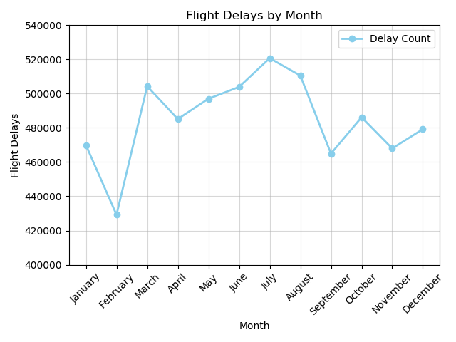
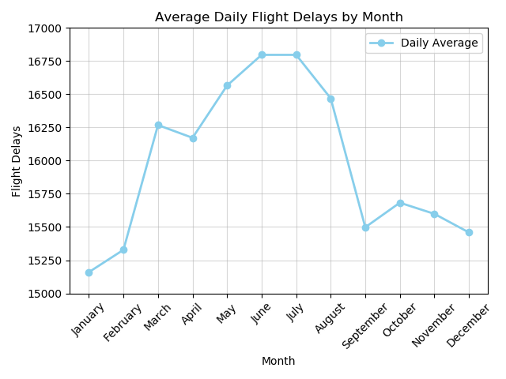
Monthly Comparison

Slide 5
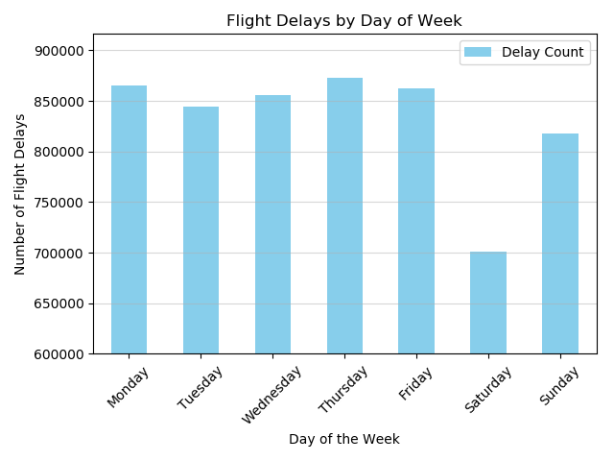
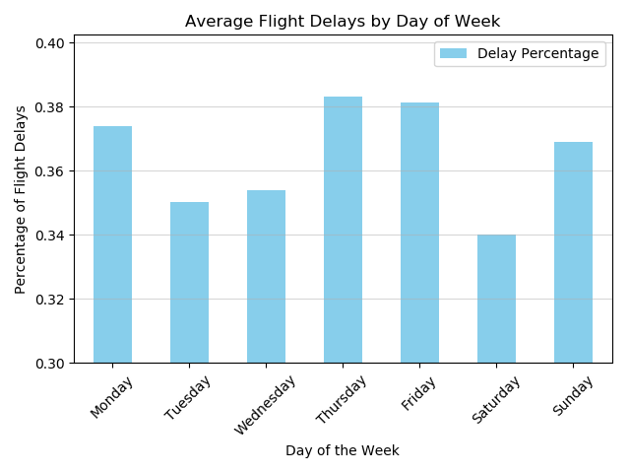
Weekly Comparison

Slide 6
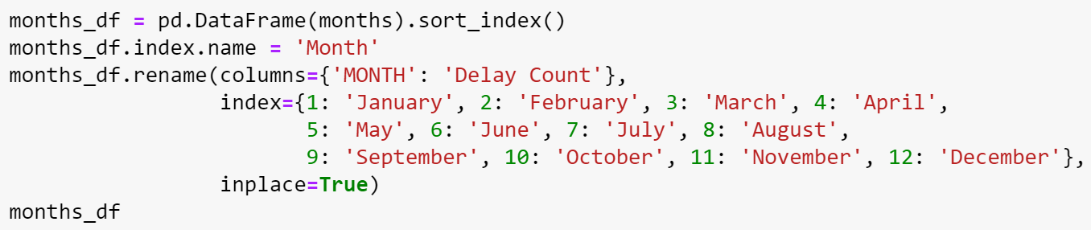
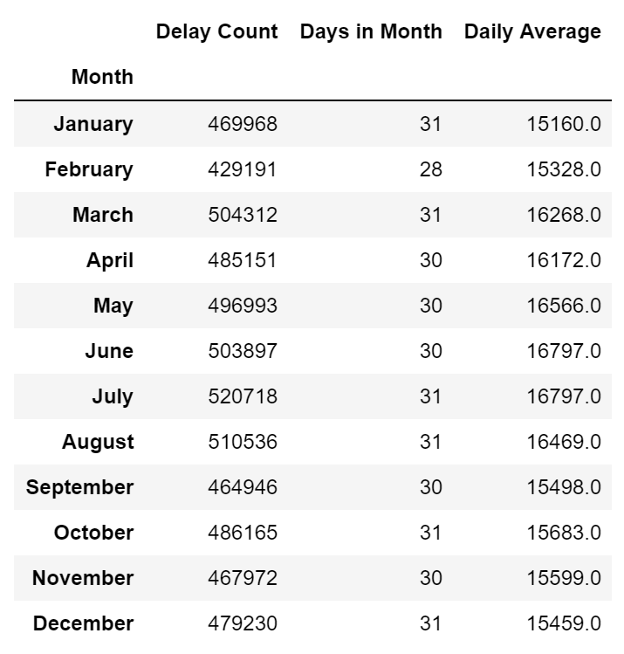
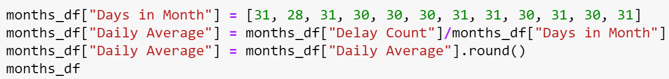
Code Showcase
Converting extracted data to an even format that can be compared

Slide 7
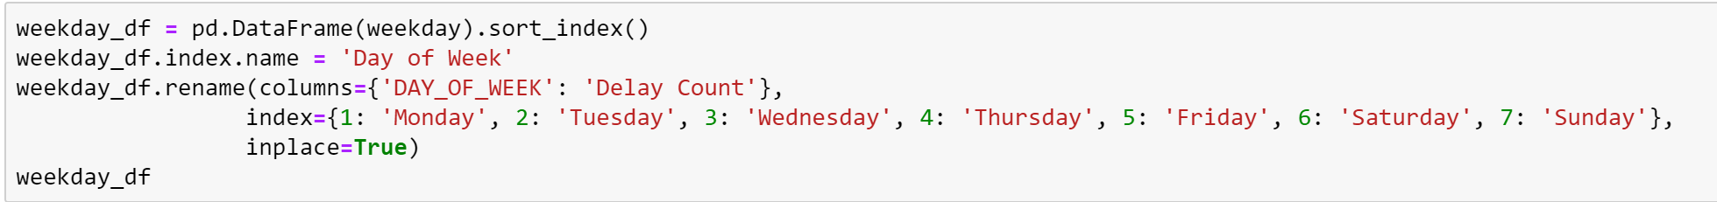
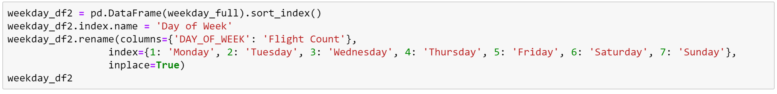
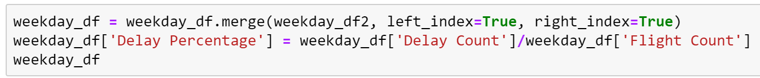
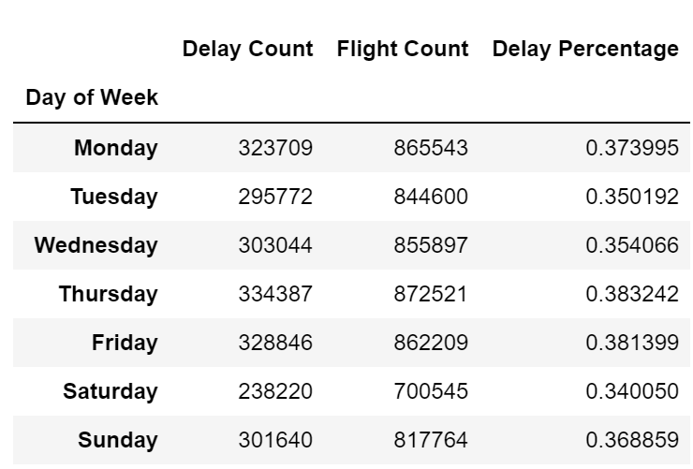
Code Showcase
Extracting data and compiling them into a new dataframe for analysis

Slide 8
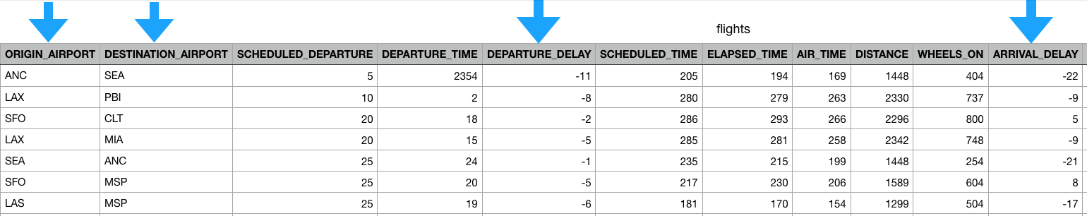
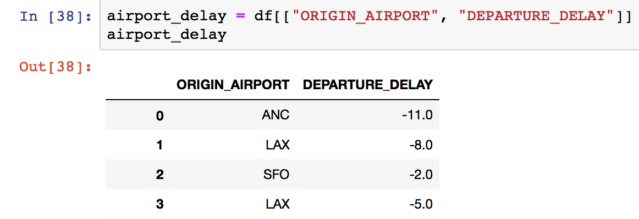
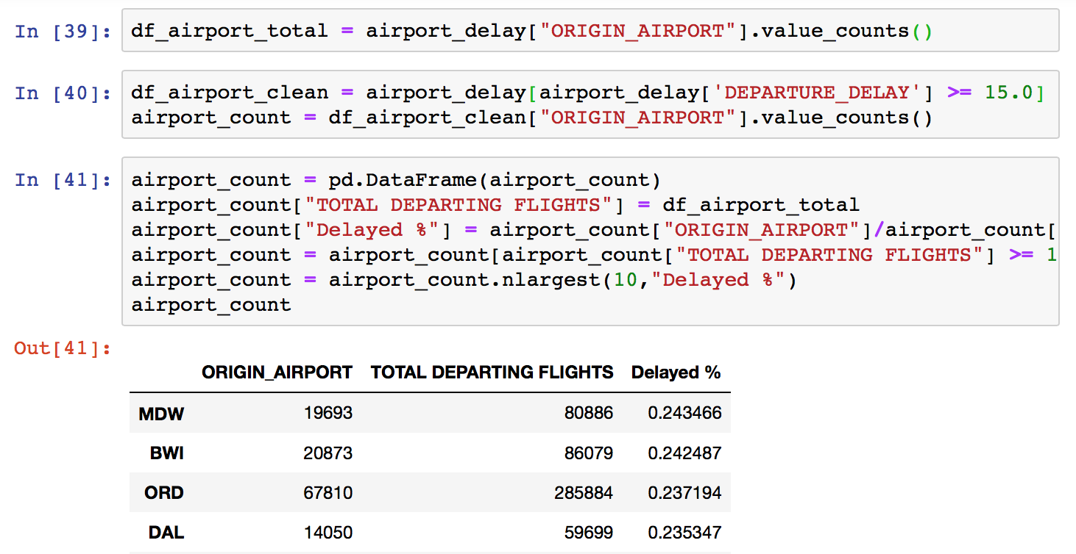
Data Cleanup & Exploration:
Which Airport Has The Most Delays?
Performed a count on number of departure delays for each airport
Did not anticipate that our dataset included early & on-time flights, represented by “ - ” and “0” respectively.
Additionally, did not anticipate the need to filter out the airports that had very few flights -- this changed the graph significantly
Filtered dataset to only include flights delayed by 15 mins or more
Filtered again for airports that have more than 10,000 flights/yr
Origin_Airport = delayed flights
Notes:
Talk about steps taken in order to clean-up data (by time, #flights)

Slide 9
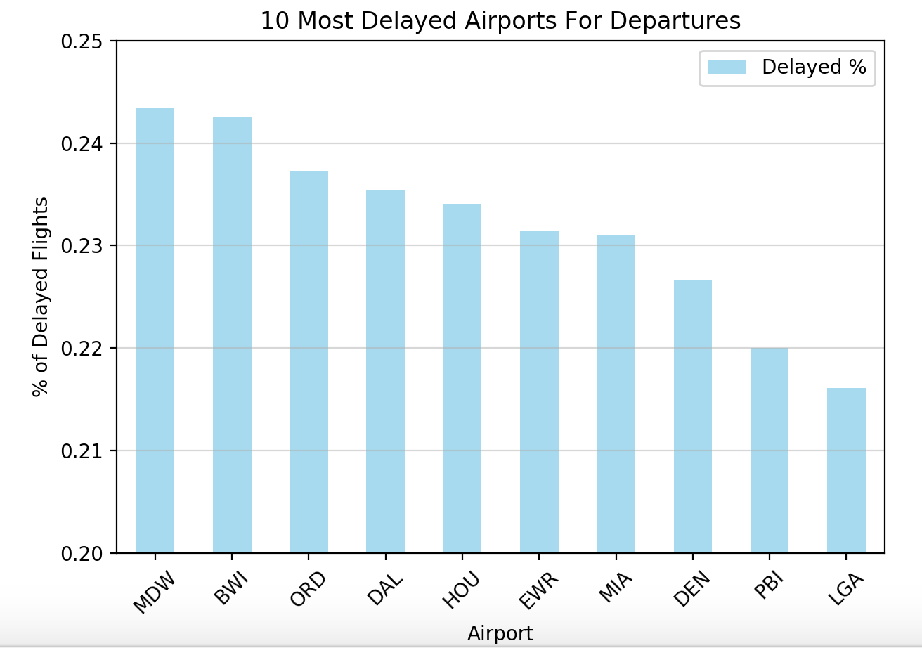
Data Analysis:
Which Airport Has The Most Delays?
Origin Airport and Departure Delay
Most = Chicago Midway Int’l
Least = LaGuardia Airport (NY)
Notes:
BWI: Baltimore-Washington Int’l EWR: Newark Liberty Int’l PBI: Palm Beach Int’l

Slide 10
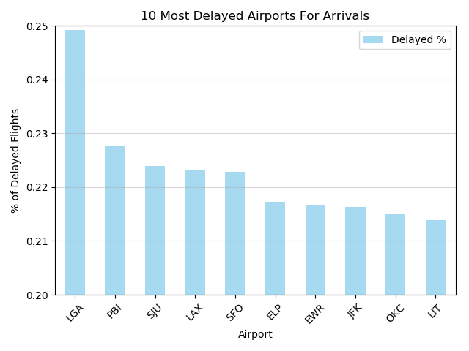
Data Analysis:
Which Airport Has The Most Delays?
Destination Airport & Arrival Delay
*Data cleanup was the same as Origin Airport & Departure Delay*
Most = LaGuardia Airport (NY)
Least = Bill & Hillary Clinton Nat’l Airport
Notes:
LGA: LaGuardia Airport (NY) PBI: Palm Beach Int’l Airport
SJU: Luis Muñoz Marín Int’l Airport (Puerto Rico) ELP: El Paso Int’l Airport (TX)
EWR: Newark Liberty Int’l Airport (NJ) OKC: Will Rogers World Airport LIT: Bill and Hillary Clinton National Airport (Arkansas)

Slide 11
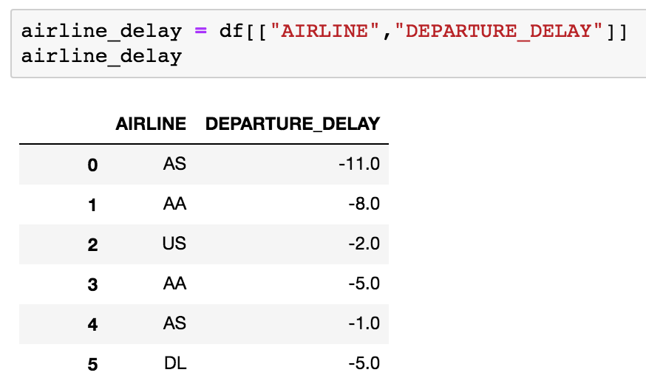
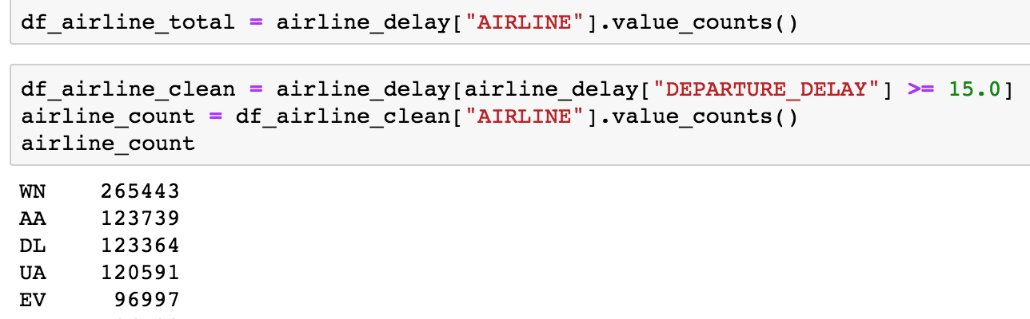
Airline Delays
Data Cleanup
Created a data frame that contains Airlines and Departure Delays
Dropped all the rows containing negative or 0 Departure Delays
This filter so you only have late departing flights in the data frame
Performed a value count which chose airlines that had the most
Departure Delays
Cleaned up the data frame according to the total amount of flights that have been delayed by 15 minutes or longer for each airline

Slide 12
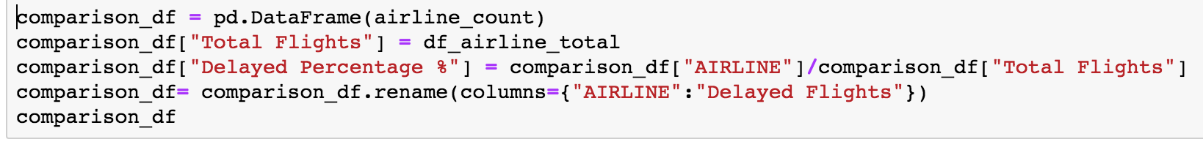
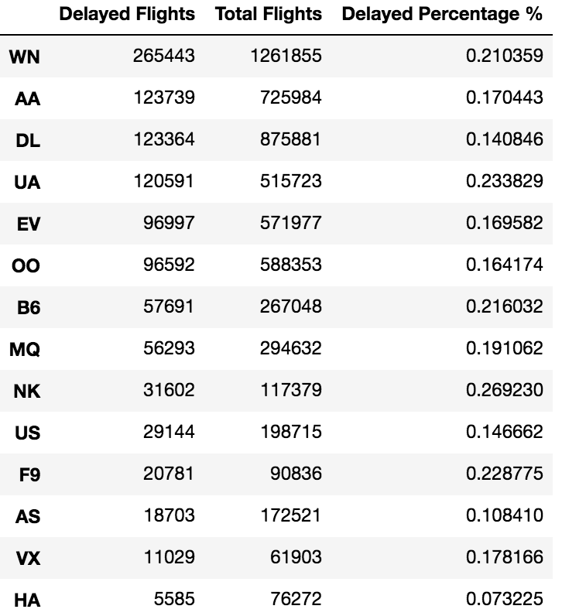
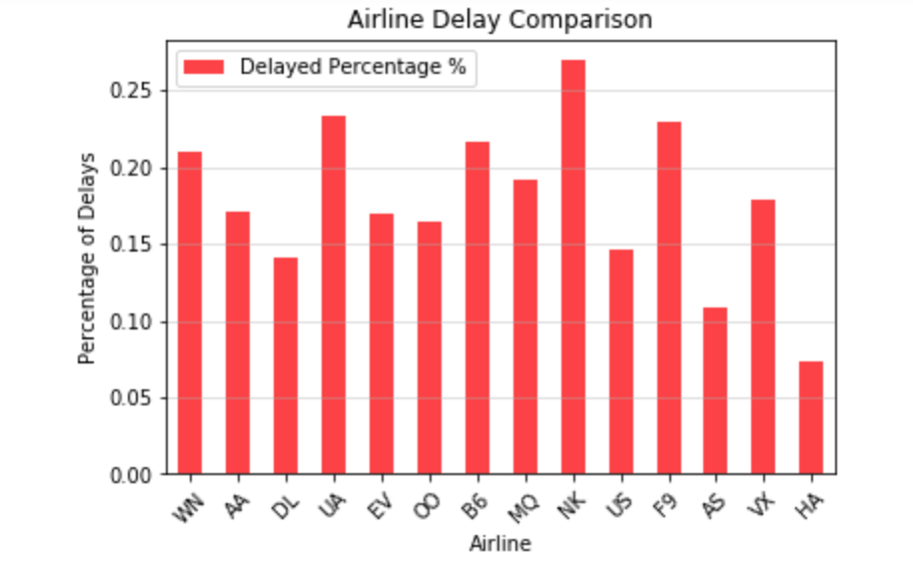
Data Cleanup Data Analysis

Slide 13
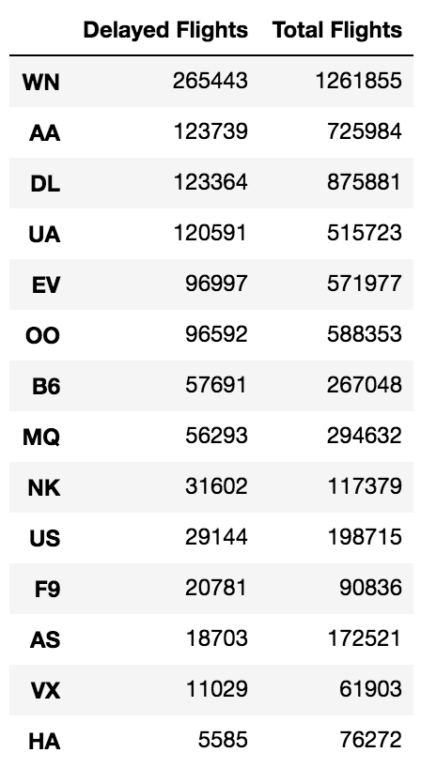
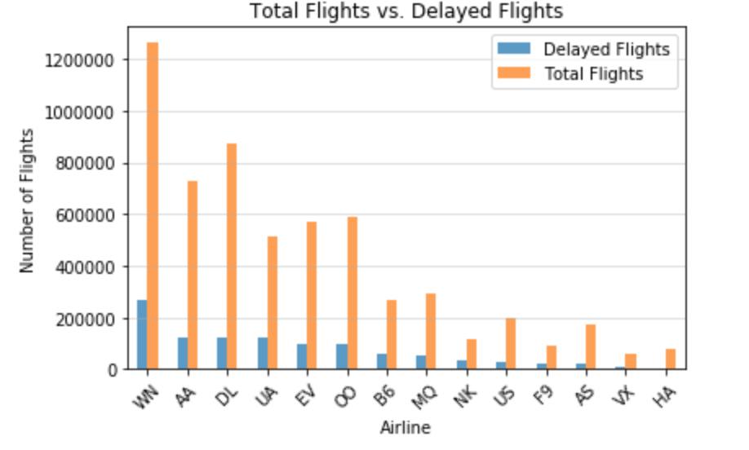
Data Analysis: Most And Least Delayed Airlines
Notes:
Dropped the percentage column
SouthWest and

Slide 14
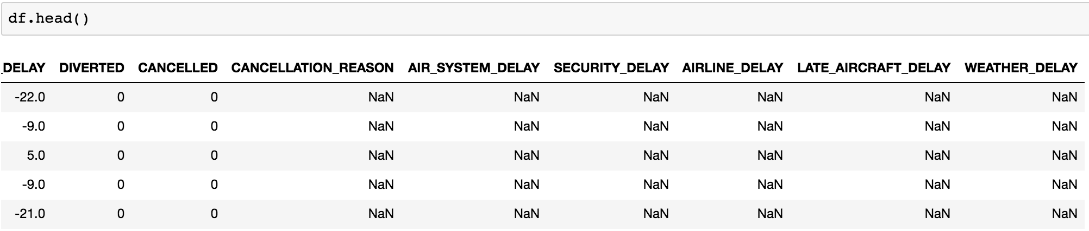
Data Cleaning for Delay Causes
-Each row represents a flight, focusing on five columns that give different reasons for flight delays
-If a flight is delayed for that column’s reason, the value is the number of minutes delayed
-NaN values are displayed if there was no delay of given type
-The first five flights of 2015 did not have any kind of departure delays, and thus display NaN
-The first column(arrival delay) shows that four of these flights arrived early, one was five minutes late arriving -The departure delay column would show that each of these flights left on time or ahead of schedule
Notes:
Air system: Air traffic control, heavy traffic volume, airport operations
Security: Extreme lines at security checkpoints, inoperative screening equipment, reboarding due to security breach
Airline: Within airline control, maintenance and crew, bagging and refueling
Late: Due to aircraft coming in late from previous destination
Weather: Extreme weather conditions, earthquake, snowstorm, tornado

Slide 15
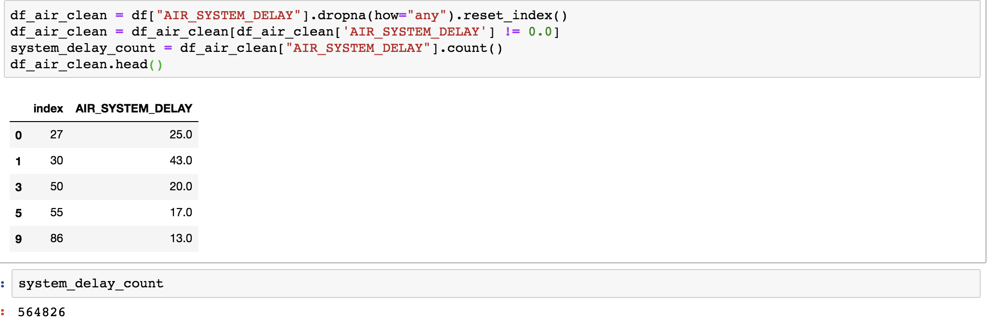
Data Cleaning for Delay Causes
Objective: Perform a count of each different type of delay, while omitting NaN values and 0’s
Obstacle: How to drop NaN values and zero’s without purging the whole column or row
Solution: Create a new dataset for each delay type which drops only NaN values and 0’s for THAT specific delay type. Now a count of that column gives the number of flights delayed due to this delay type.

Slide 16
Data Cleaning for Delay Causes
Objective: Rather than number of flights, determine total minutes of delays by type
Solution: Much more straightforward, simple sum function of the column, convert to hours (because sum does not need to purge NaN values or 0’s)

Slide 17
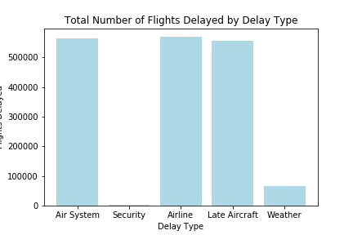
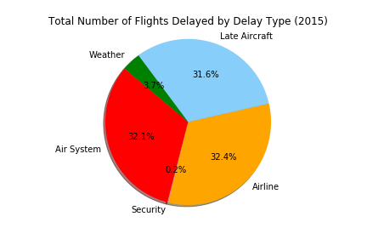
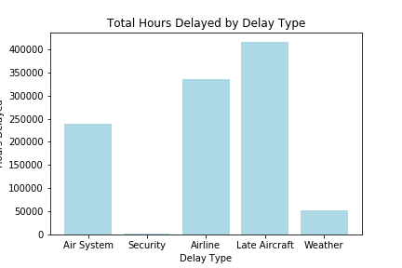
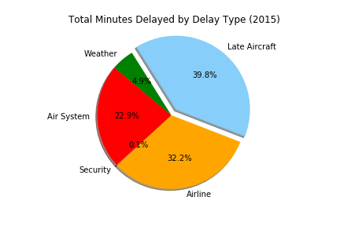
Findings:
-Air system delays caused about as many delayed flights as airline and late aircraft, but the actual length of each delay is lower on average.
-Conversely, late aircraft caused fewer delayed flights than air systems or airlines, but accounted for the most delay minutes so each delay was longer on average.
-The fact that weather delays account for such a small minutes delay total is surprising. Would attribute it to the sheer volume of flights and not that many of them being affected by extreme weather conditions.

Slide 18
The Bureau of Transportation Statistics already did a study on this! Does our data match up?
“The most common cause of delays is late-arriving aircraft, which accounted for 41.9% of total tardiness minutes in 2014. This situation causes a ripple effect to other flights.”
“Air carrier delays were the second most common hold-up in 2014 and accounted for 30.2% of total delay minutes. These cancellations or delays are related to circumstances within the airline’s control, including maintenance or crew problems, aircraft cleaning, baggage loading and fueling.”
“National Aviation System (NAS) delays refer to a broad set of conditions including non-extreme weather, airport operations, heavy traffic volume and air traffic control. In 2014, NAS accounted for 23.5% of total delay minutes.”
“In 2014, delays due to extreme weather accounted for 4.3% of total delay minutes. Canceling flights due to weather is at the judgment of the carrier. Common causes of delays include tornados, blizzards and hurricanes.”
Security accounted for a relatively low percentage—0.1%—of delay minutes for U.S. airlines last year. Security reasons range from an evacuation of a terminal or concourse, reboarding of aircraft because of security breach, inoperative screening equipment or long lines at screening areas in excess of 29 min.
Source: Bureau of Transportation Statistics

Slide 19
Discussion/Conclusion
-The most minutes delayed were caused by a late arriving aircraft from a previous destination (39.8%), however the most common ROOT causes for a flight delay were airline specific delays (32.2%) and air system delays (22.9%).
-So if your flight is late, it’s probably because the plane is late coming in - but that was probably caused directly by your specific airline! Blame your airline!
-It was surprising to see that LaGuardia Airport has the least amount of departure delays, but the most amount of arrival delays
-Saturdays are the best days to fly throughout the year, and the best month to fly in is September.
- Best Airlines to fly with are Hawaiian and Virgin
-Best airport is

Slide 20
Post Mortem
Delay Types: A difficulty that arose was determining the base meaning of each delay type. At first, ‘Late Aircraft Delay’ looked like a general catch-all for any delay not falling into a different category. Through some quick research, we found that it actually meant a departure delay due to a flight coming in late from a previous destination.
An interesting analysis point for next time would be to determine which specific airline had the fewest total airline specific delays. This would give us an idea of which airline is the best at cutting out controllable delays.
Day/Month: If we had more time I would have liked to see if the time of day affects the frequency of flight delays and cancellations.

